Slide 1
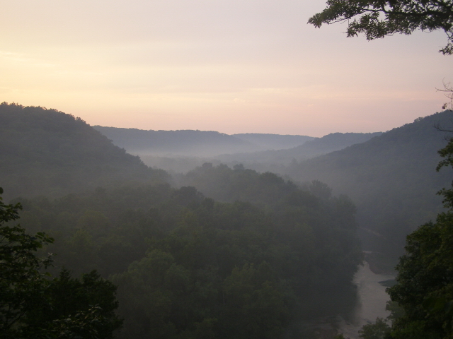
Mammoth Cave Area
International Biosphere Reserve

Slide 2
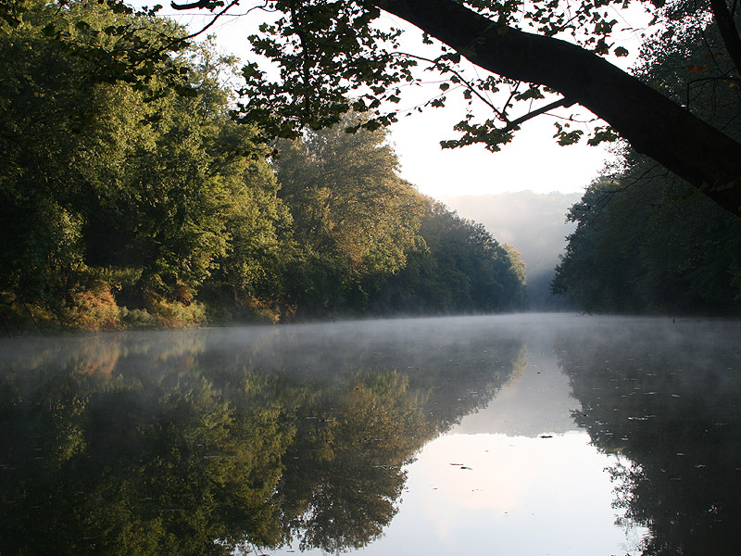
What is a biosphere reserve?
an internationally recognized place where
government policy makers, scientists, and local residents cooperate to
manage resources to meet human needs while conserving natural resources.
Notes:
River Environment:
Green River supports a diverse population of fish (82 species) and invertebrate fauna, (250 species) including over 50 species of mussels (7 endangered).

Slide 3
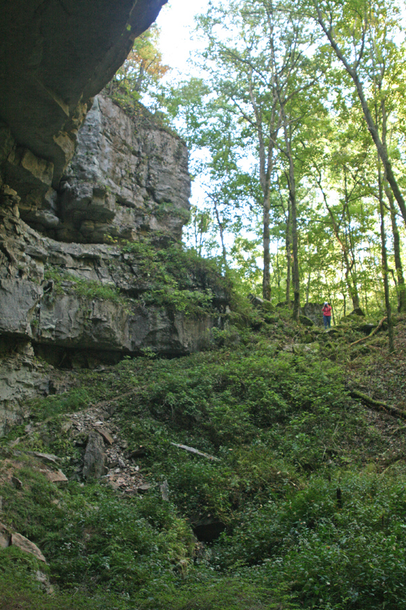
1980s
BRADD and Mammoth Cave National Park submitted a nomination to the United Nations Educational, Scientific, and Cultural Organization for a new biosphere reserve to be designated in south central Kentucky.

Slide 4
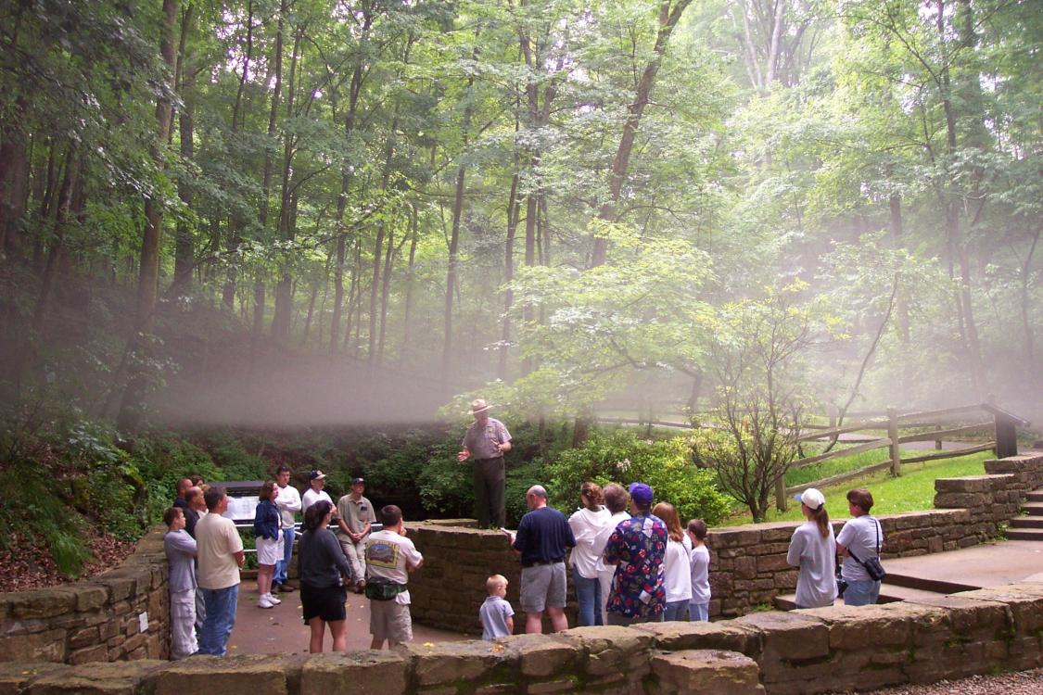
1990
Mammoth Cave Area Biosphere Reserve received the honorary designation; 112,800 acres, a karst system of underground water courses that includes the longest cave in the world.
(52,800-acre park as the core area + 68,000-acre interaction zone)

Slide 5
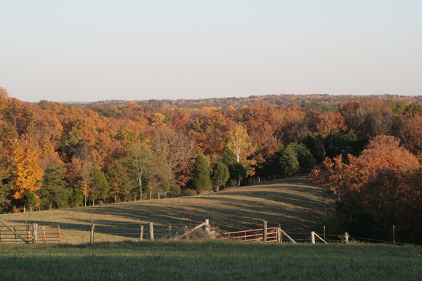
1992
A memorandum of understanding established the first Biosphere Reserve Advisory Council.

Slide 6
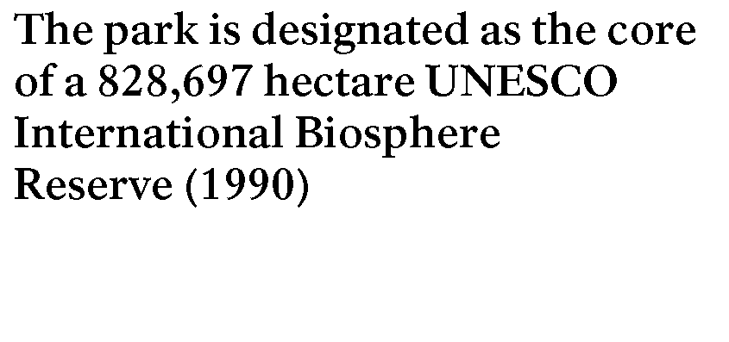
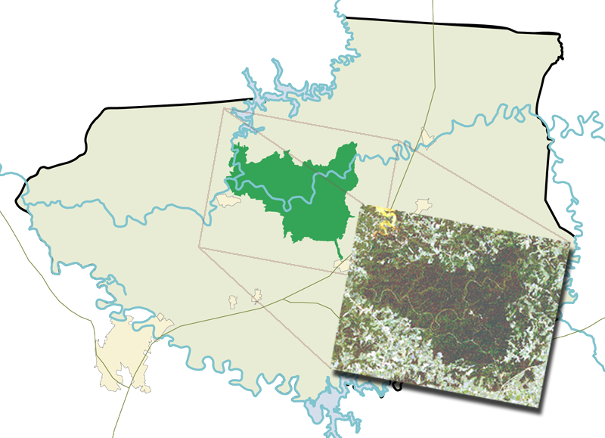
1996
BRADD and the park petitioned to expand the Biosphere Reserve to 909,328 acres in
six counties because of a common
concern for water quality.
Nolin
Green
Little Barren
Counties:
Edmonson
Butler
Hart
Barren
Metcalfe
Warren
Barren
Notes:
An International Biosphere Reserve
The park is designated as the core of a 828,697 hectare UNESCO International Biosphere Reserve (1990). (47 BRs in the US; two in Kentucky)
Mammoth Cave National Park is the core of an International Biosphere Reserve, and an island of biodiversity.
Biodiversity examples --
>1100 sp flowering plants
82 types of trees
203 sp birds
43 sp mammals
29 sp amphibians
38 sp reptiles
(The yellow area on the aerial photo, northwest of the park, is Nolin River reservoir)

Slide 7
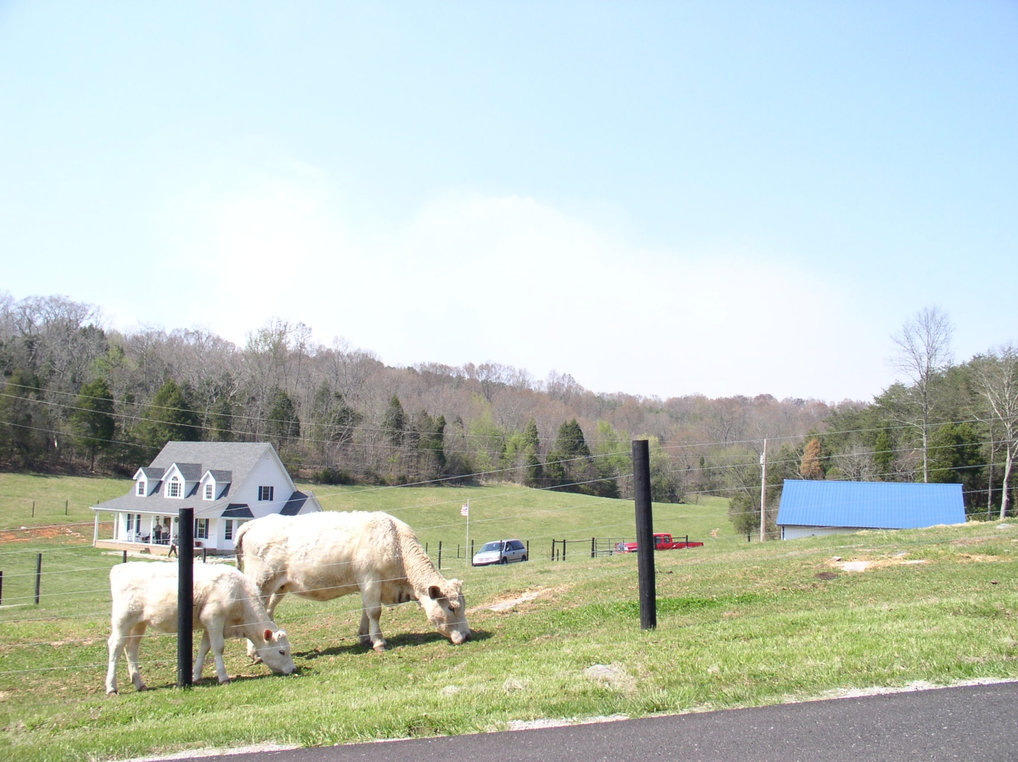
2010
The Biosphere Reserve Advisory Council memorandum of understanding was renewed by the BRADD Board in March 2010.
The Biosphere Reserve Advisory Council includes a 15-member Policy Committee.

Slide 8
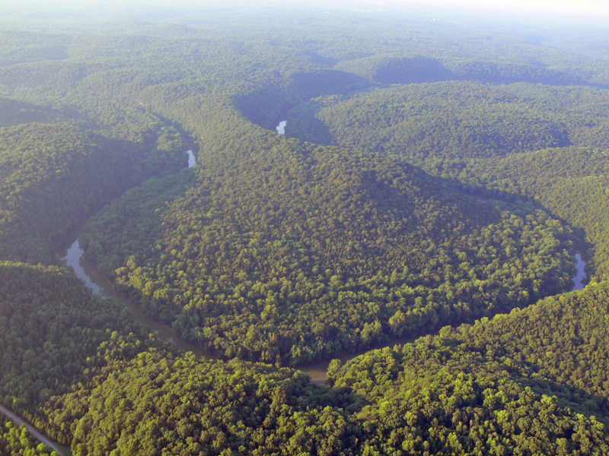
A biosphere reserve designation:
is honorary and non-regulatory;
encourages sustainable economic development;
promotes understanding of karst landscape;
is directed by the Biosphere Reserve Advisory Council,
coordinated through BRADD.

Slide 9
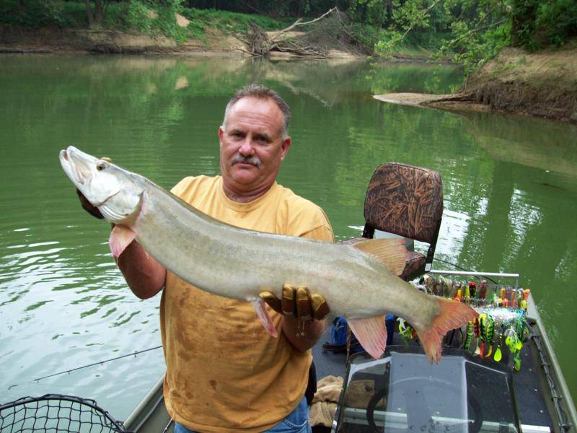
Past Advisory Council goals:
reduce water pollution;
promote sustainable economic growth;
establish a regional GIS system;
assist area landowners in improving their land-use practices;
promote karst education.

Slide 10
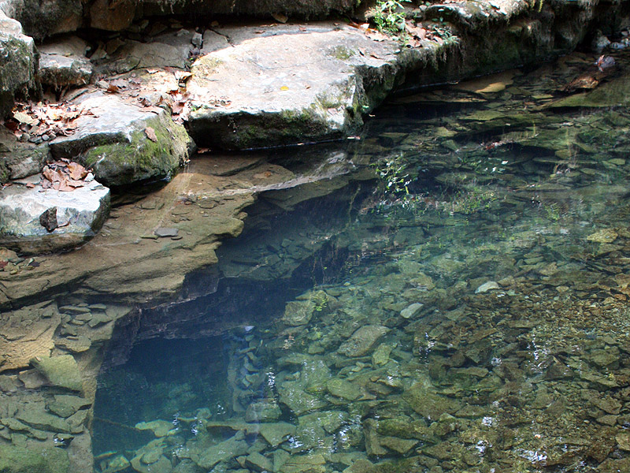
What is karst?

Slide 11
What is karst?
Karst landscape is an area of irregular limestone, where erosion has produced sinkholes, underground streams, and caverns.

Slide 12
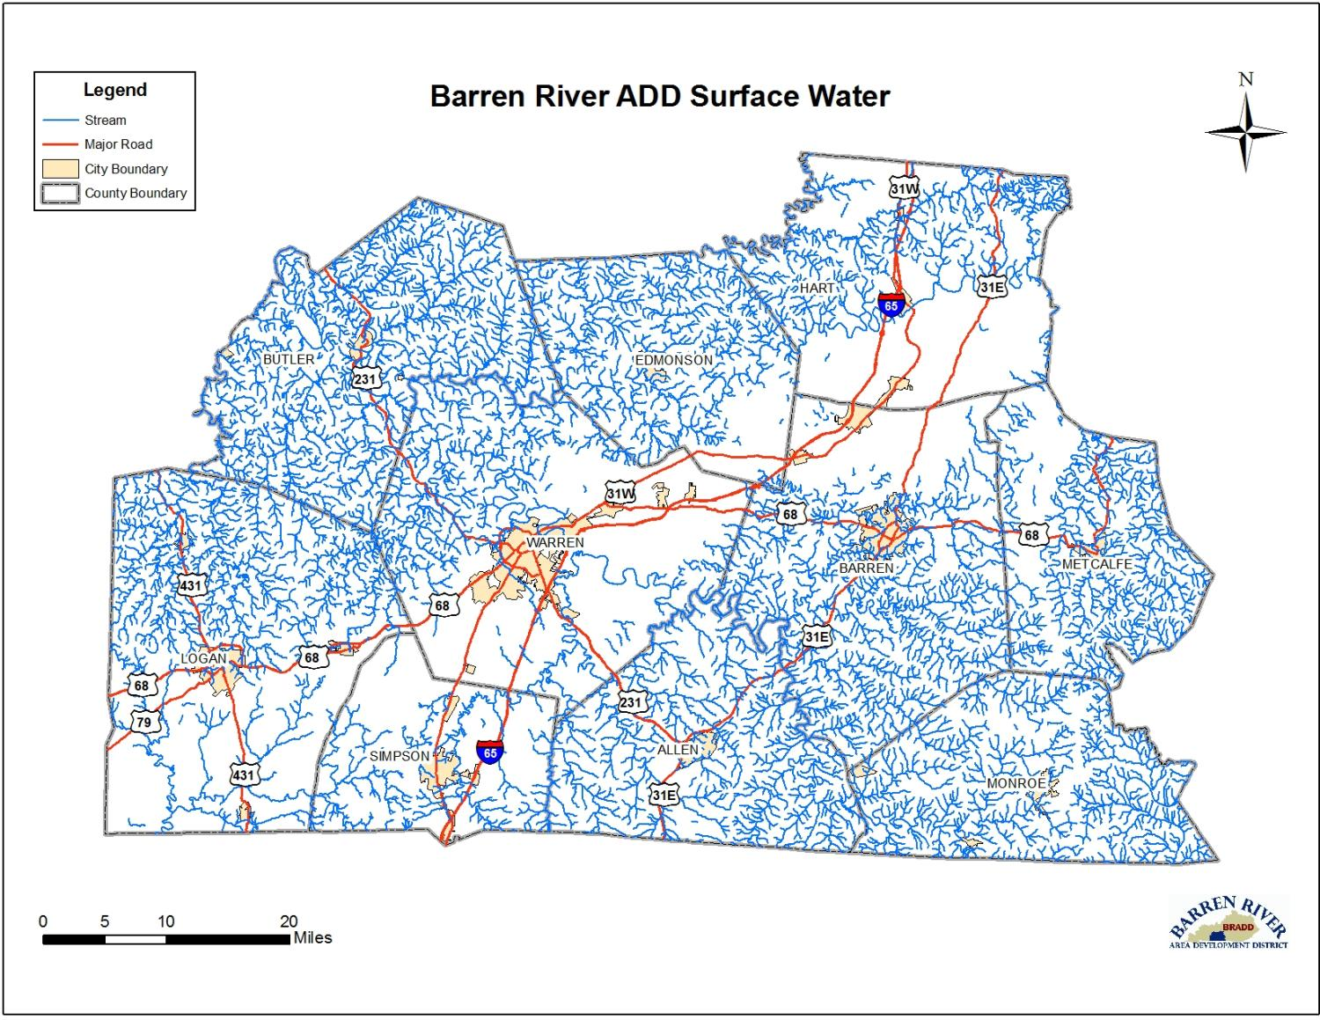
On a map, karst terrain is evidenced by a lack of surface streams.
Barren River ADD Surface Water
Notes:
Cave and Karst:
Mammoth Cave is the world’s longest known cave—
587 km (365 miles) and still not fully explored—
and is the core of one of the best understood karst areas on Earth.

Slide 13
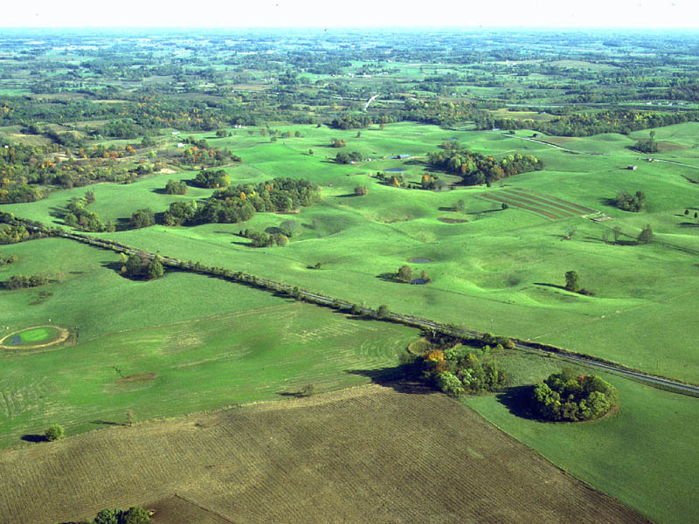
Rain falling on a karst landscape drains into sinkholes instead of surface streams.
Notes:
13

Slide 14
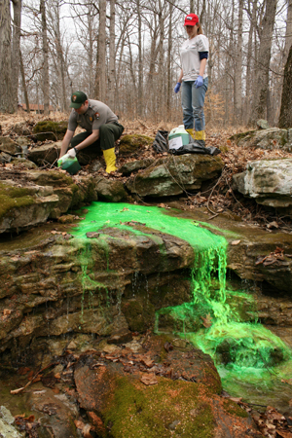
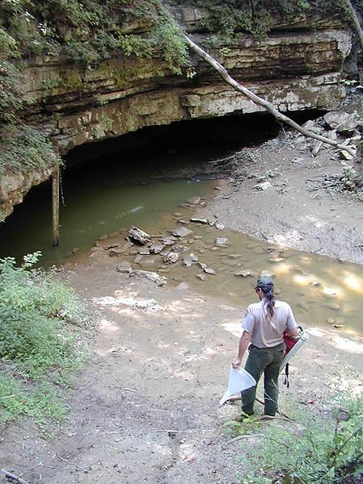
40 years of dye-tracing has revealed the extent of the Mammoth Cave System.

Slide 15
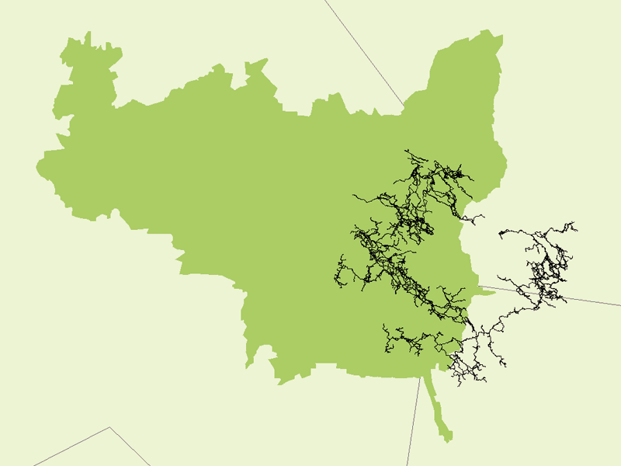
Hart County
Mammoth Cave National Park
Edmonson County
Mammoth Cave is 390 miles long; one of 400 caves within the park.
Barren County
Notes:
Extent of the System
The Mammoth Cave system’s 587 km of passages extend partially outside the park’s boundary.

Slide 16
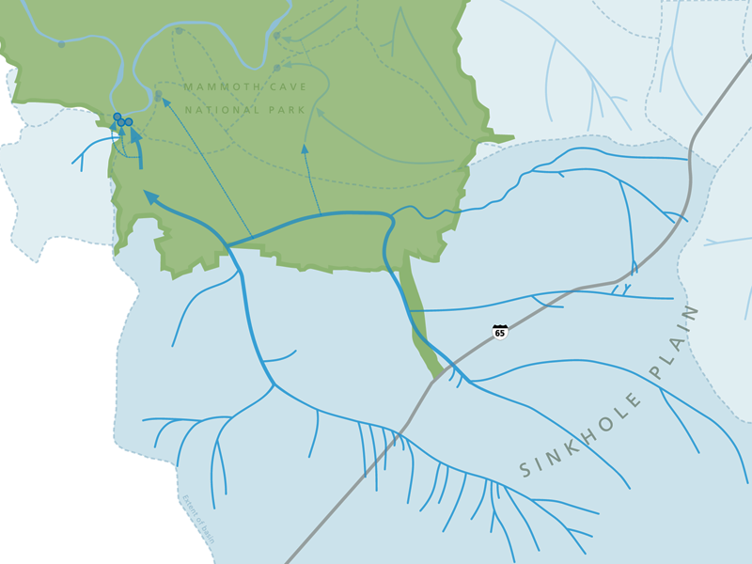
Mammoth Cave
is part of an underground
watershed that feeds into
Green River.
Rain that falls on
the sinkhole plain
flows through caves
on its way to Green River.

Slide 17
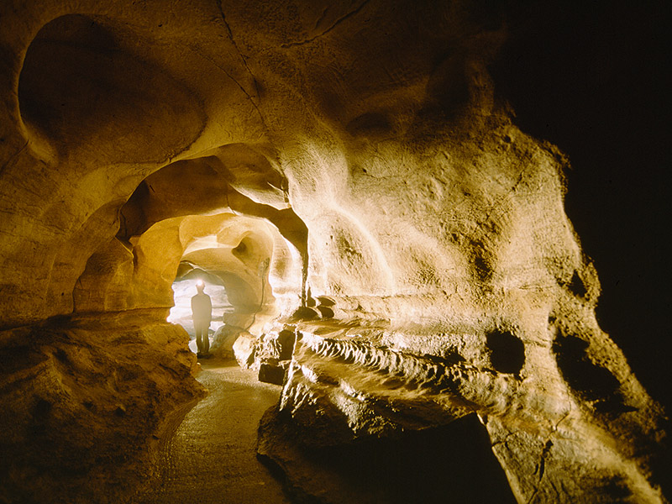
Cave tour routes through Mammoth and other area show caves are dry riverbeds. Within the biosphere reserve, many landowners are also cave owners.

Slide 18
Cave tour routes through Mammoth and other area show caves are dry riverbeds. Within the biosphere reserve, many
landowners are also cave owners.
Partnering with BRADD and community leaders is the best way to protect Mammoth Cave.

Slide 19
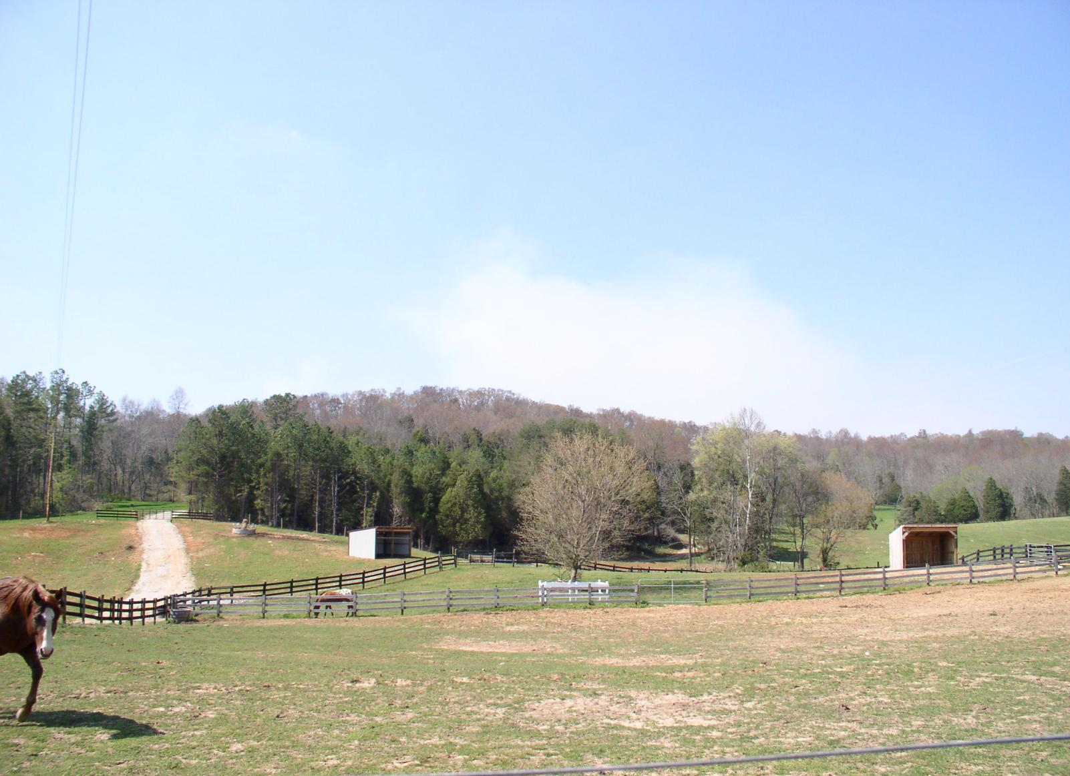
What has been accomplished through the Advisory Council?
the Haz-Map, used by all environmental emergency responders in protecting groundwater from spills along Interstate-65 and the CSX railroad;
a regional GIS system benefiting all BRADD counties;
support for best management practices: manure containment structure grants, and highway catchment basins that slow the flow hazardous spills;
the regional sewer system that benefits communities, businesses, and the health of cave systems.

Slide 20
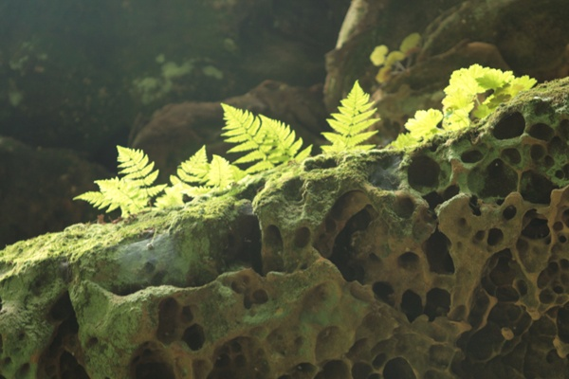
What’s next?
The future goals of the Biosphere Reserve Advisory Council will focus on:
economic development;
environmental protection;
karst education and awareness.

Slide 21
